Slide 1
Greenhouse Gas Accounting in Agriculture:
Dairy Industry Experience
Greg Thoma
Darin Nutter
Rick Ulrich
Dae Soo Kim
College of Engineering, University of Arkansas
Marty Matlock
Jennie Popp
Nathan Kemper
Zara Niederman
UA Center for Agricultural and Rural Sustainability
David Shonnard
Felix Adom
Charles Workman
Chemical Engineering, Michigan Technological University

Slide 2
Why an LCA of Milk Production?
Consumers are interested in product sustainability.
  Increasing willingness to make purchase decisions based on (perceived) environmental impacts.
  Potential for reduction in consumption of dairy.
Science-based LCA can provide:
  Data that will allow the industry to identify and engage more sustainable approaches
  Reduce environmental impacts that can be validated through LCA measurements.
Other benefits:
  Systems understanding allows positioning dairy products in the marketplace based on sustainable attributes respond proactively to consumer concerns.
  Supports industry’s ability to work with retailers to educate consumers about agricultural and food sustainability issues.
  Establish a baseline for GHG offset projects which may result from legislation in the future

Slide 3
LCA Methodology
ISO 14044 compliant
Goal: Determine GHG emissions
associated with consumption of one gallon of milk to US consumer.
Scope: Cradle to grave. Specifically including pre-combustion burdens for primary fuels and disposal of packaging.
National Scale Analysis – drives data collection

Slide 4
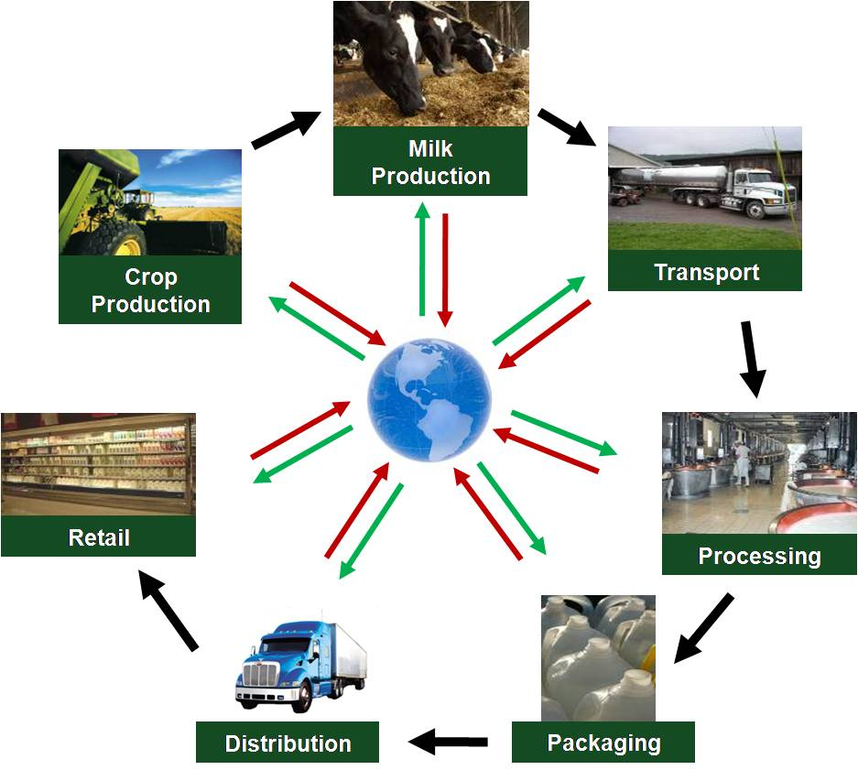
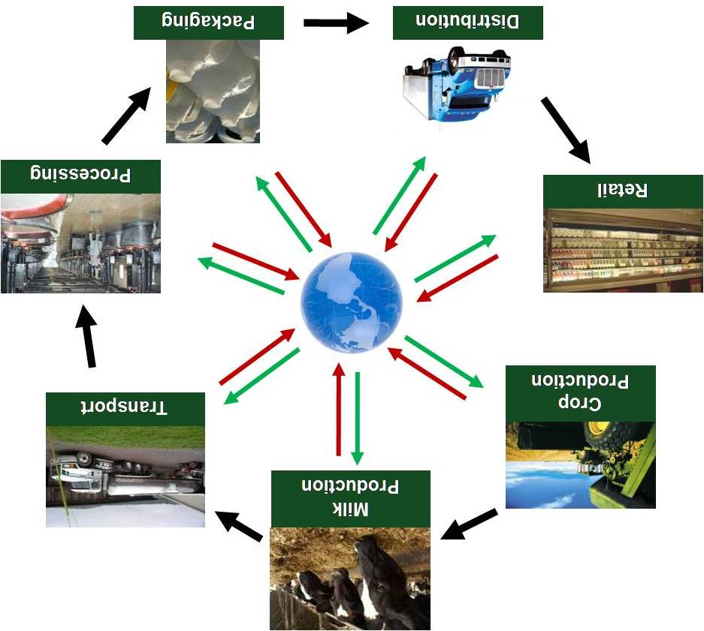

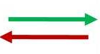
Global Warming Potential of Fluid Milk
Scope: grass to glass
Consumer/ End of Life
Waste &
Pollution
Resources
&Energy
Notes:
4

Slide 5
Life Cycle Inventory –
Data Drives the Work
Surveys:
  Dairy Producer (~535; 9% response rate)
  Farm to processor transportation data
  (~150,000 round trips – 2007 only)
  Milk Processor (50 plants responded)
Published Literature:
  Peer Reviewed Literature
    Enteric Methane, Nitrogen and Methane from manure management
    Life cycle inventory data for crop production (NASS, Budgets, USLCI)
  Other Publications (e.g. IPCC, EPA)
  Expert opinion
Notes:
5

Slide 6
Dairy Feed: crop production
Fertilizer, pesticides, fuel & processing

Slide 7
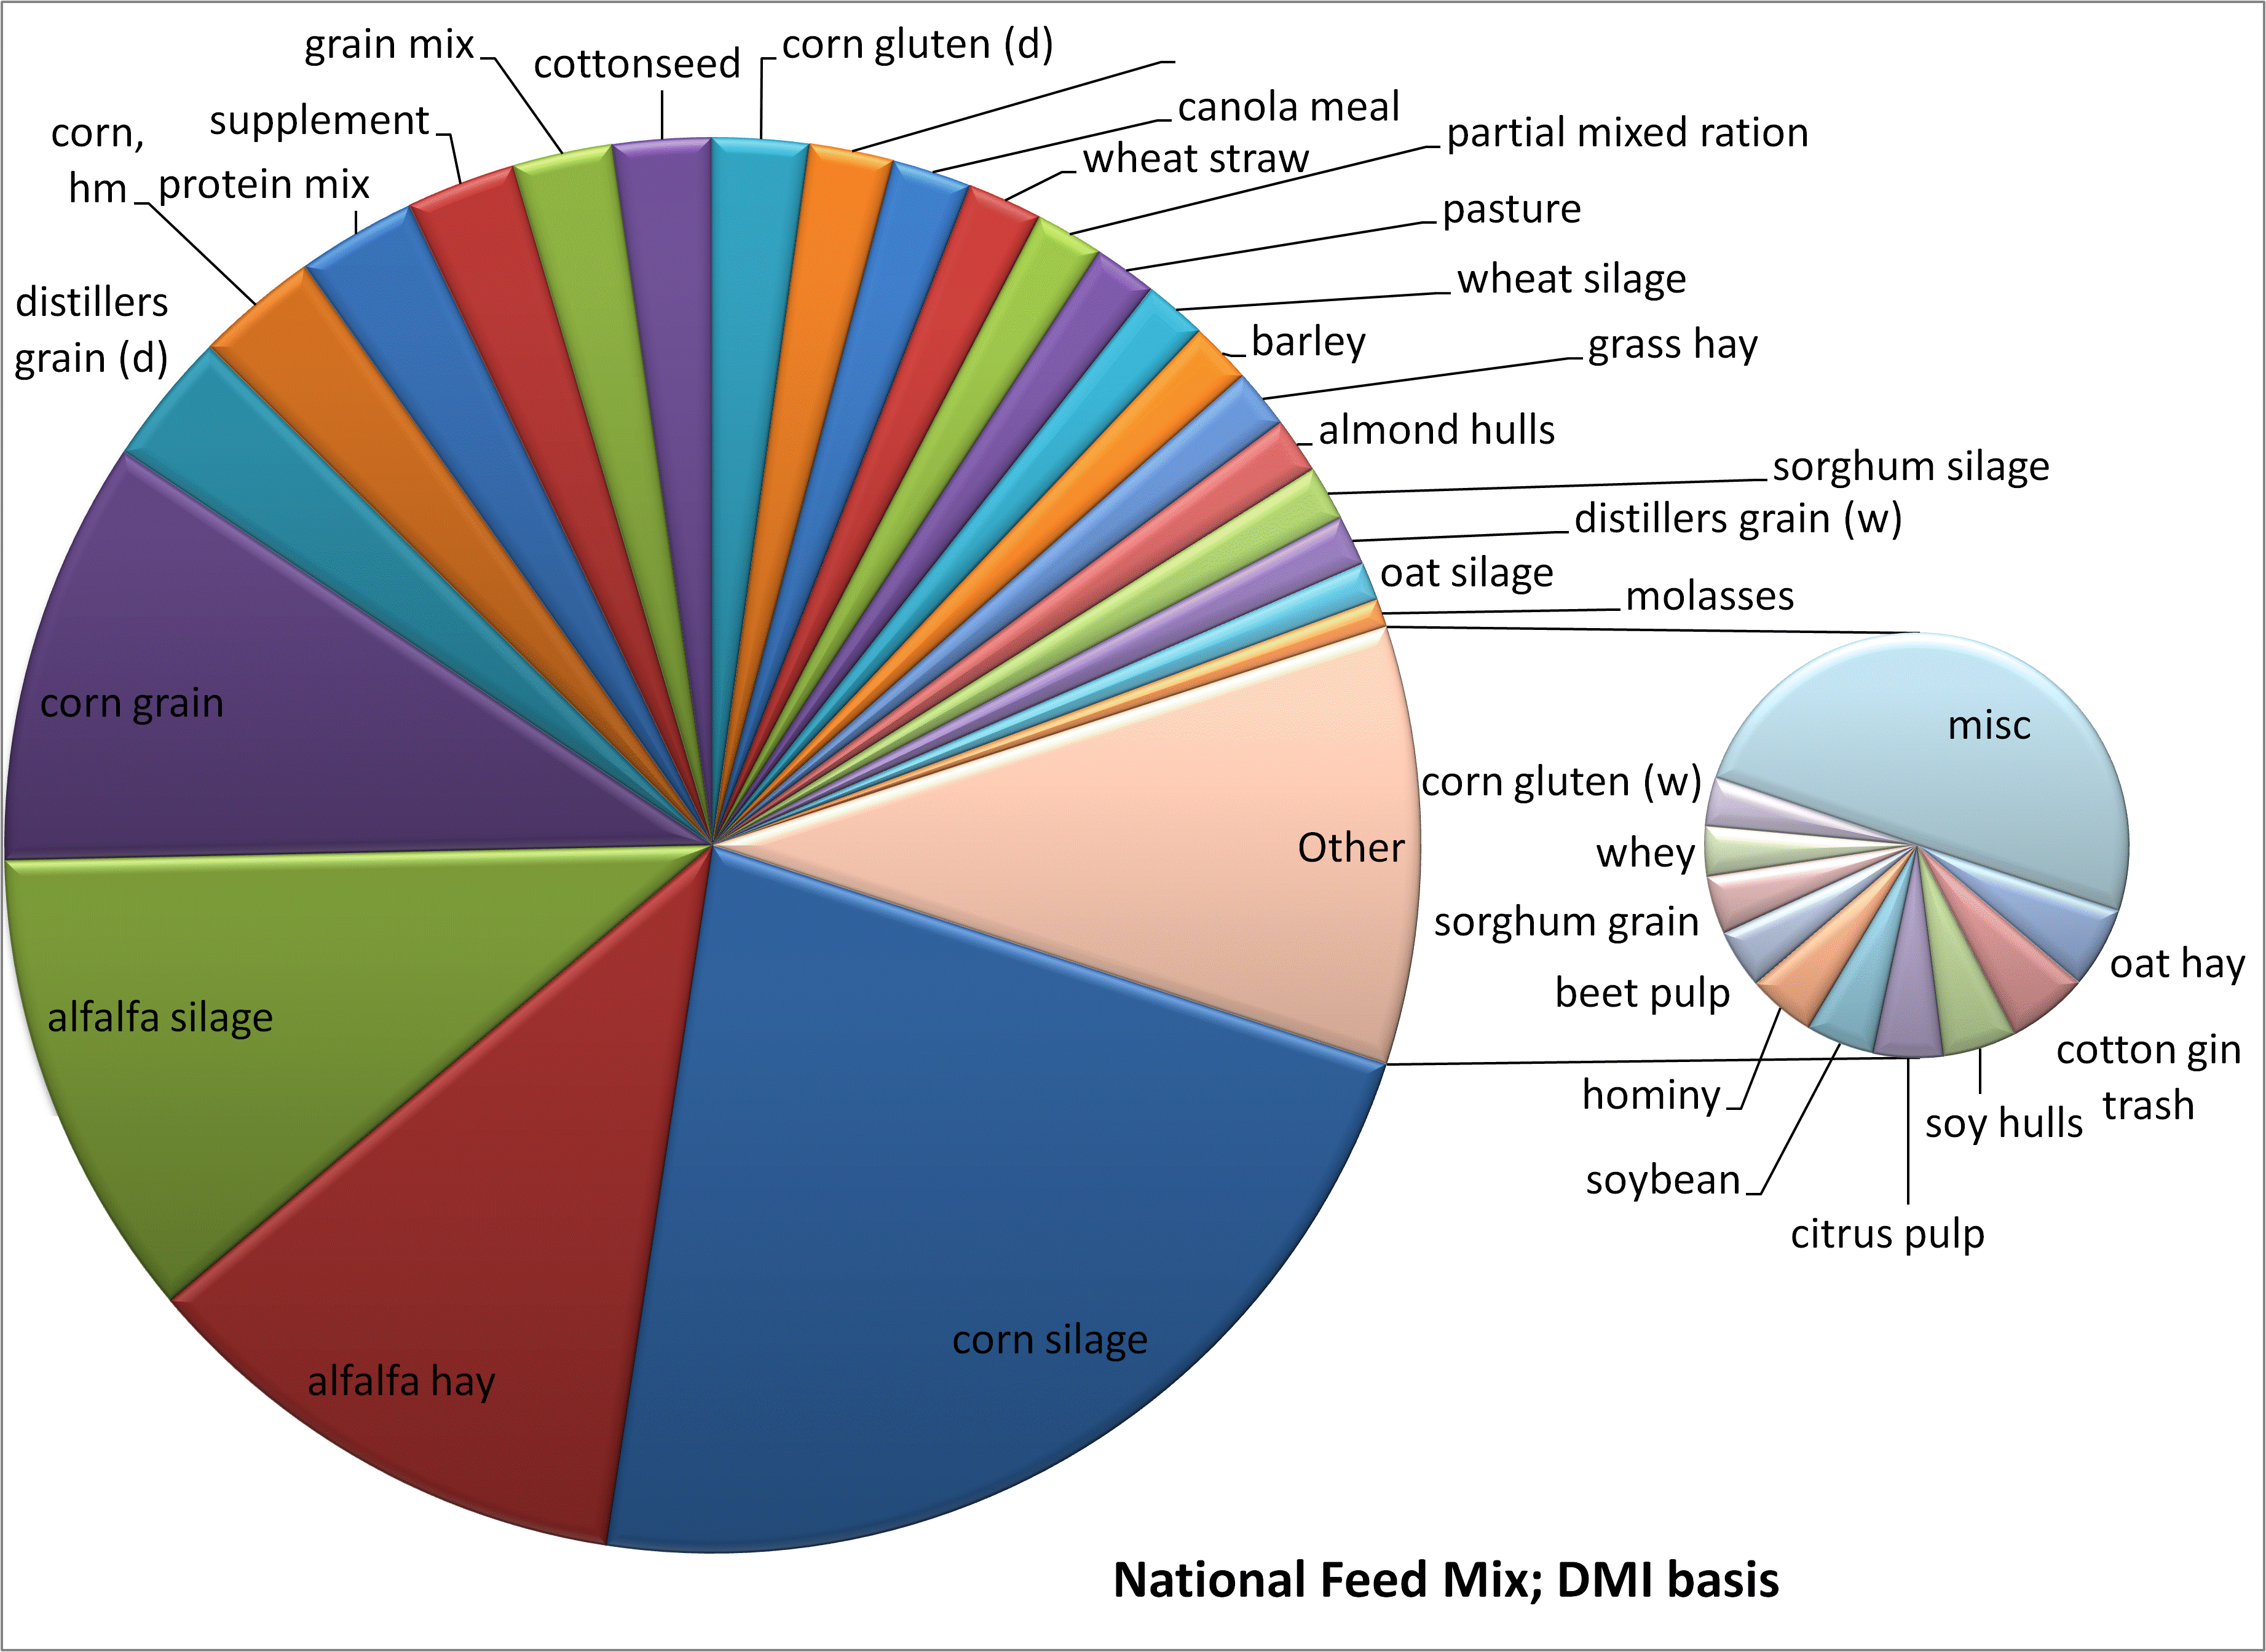
What Cows Eat
Notes:
7
USDA Briefing Section 10b

Slide 8
Calculating Feed Footprint:
Data Sources
NASS data on fertilizers, fuels, pesticides and other inputs
  States with complete data averaged
  CO₂e burden of inputs accounted
  Production burdens and N₂O from field accounted
Production budgets from state Ag extension agents used for silage, hay, and pasture
  Budget prices converted to estimated quantities
  Similar accounting: state budgets aggregated and CO2e accounted

Slide 9
Data Challenges
Incomplete data sets
  Fertilizer type by crop, pesticides, fuel use
Complexity of dairy rations
  Lack of extant LCA for many items
    Almond hulls, citrus pulp, apple pomace
    Surrogate feeds adopted
Crop production practices
  Tillage, soil type, etc affect N₂O
  Lime fate (soil acidity)
Consistency of background data
  System boundaries, linking to relevant upstream information

Slide 10
Challenges: Allocation
  System expansion
  Physical causality
  Economic value
  Mass/Energy content
  By-products:
    Distiller’s grains, grain meals, pulp, etc
  Milk and beef
  Cream and milk products
Refrigeration at retail and in-home

Slide 11
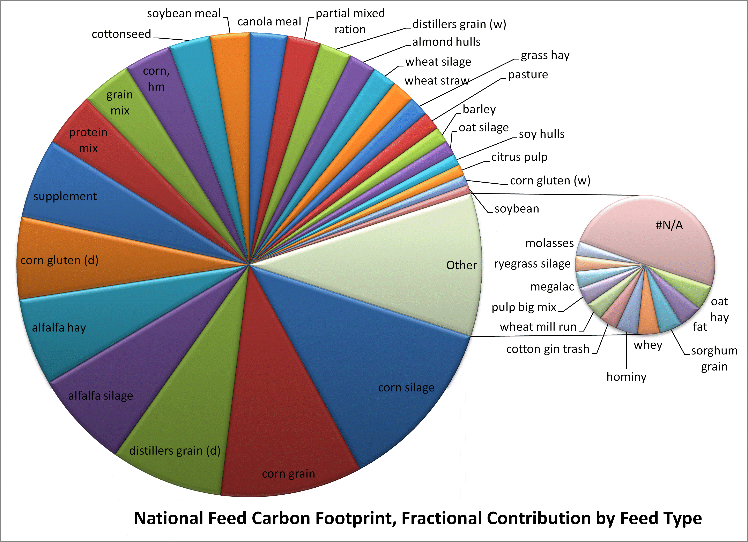
The Feedprint
Notes:
11
USDA Briefing Section 10b

Slide 12
Dairy Fluid Milk
Farm Level Data Collection
Producer Survey
for On-Farm Data
Collect representative data from U.S. dairy producers to establish a carbon footprint baseline relevant to conditions in the United States.
Single farm footprint will have similar goal, but obviously require site specific data and understanding of practices

Slide 13
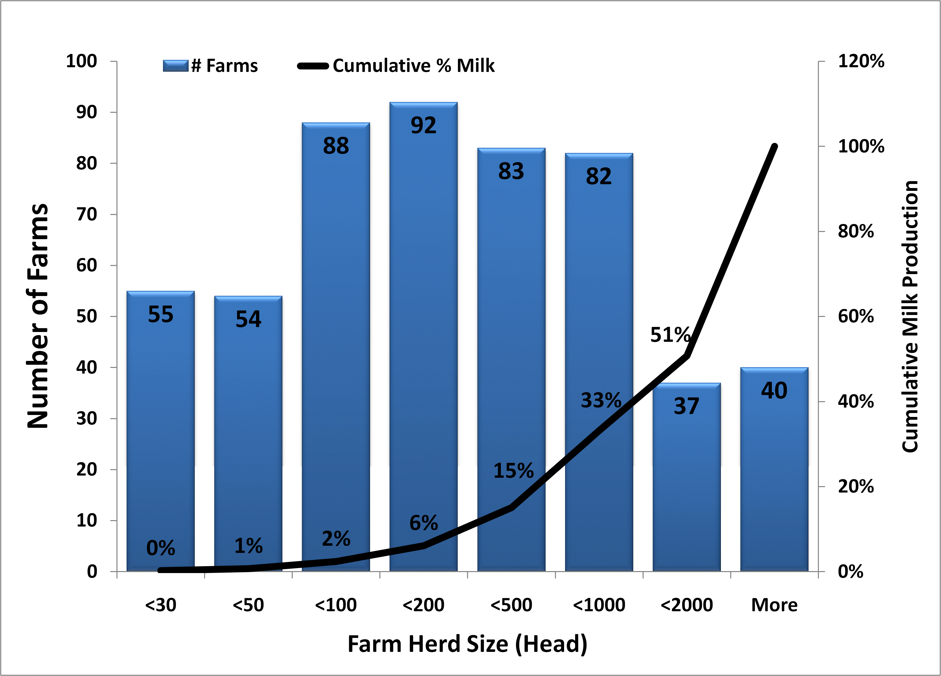
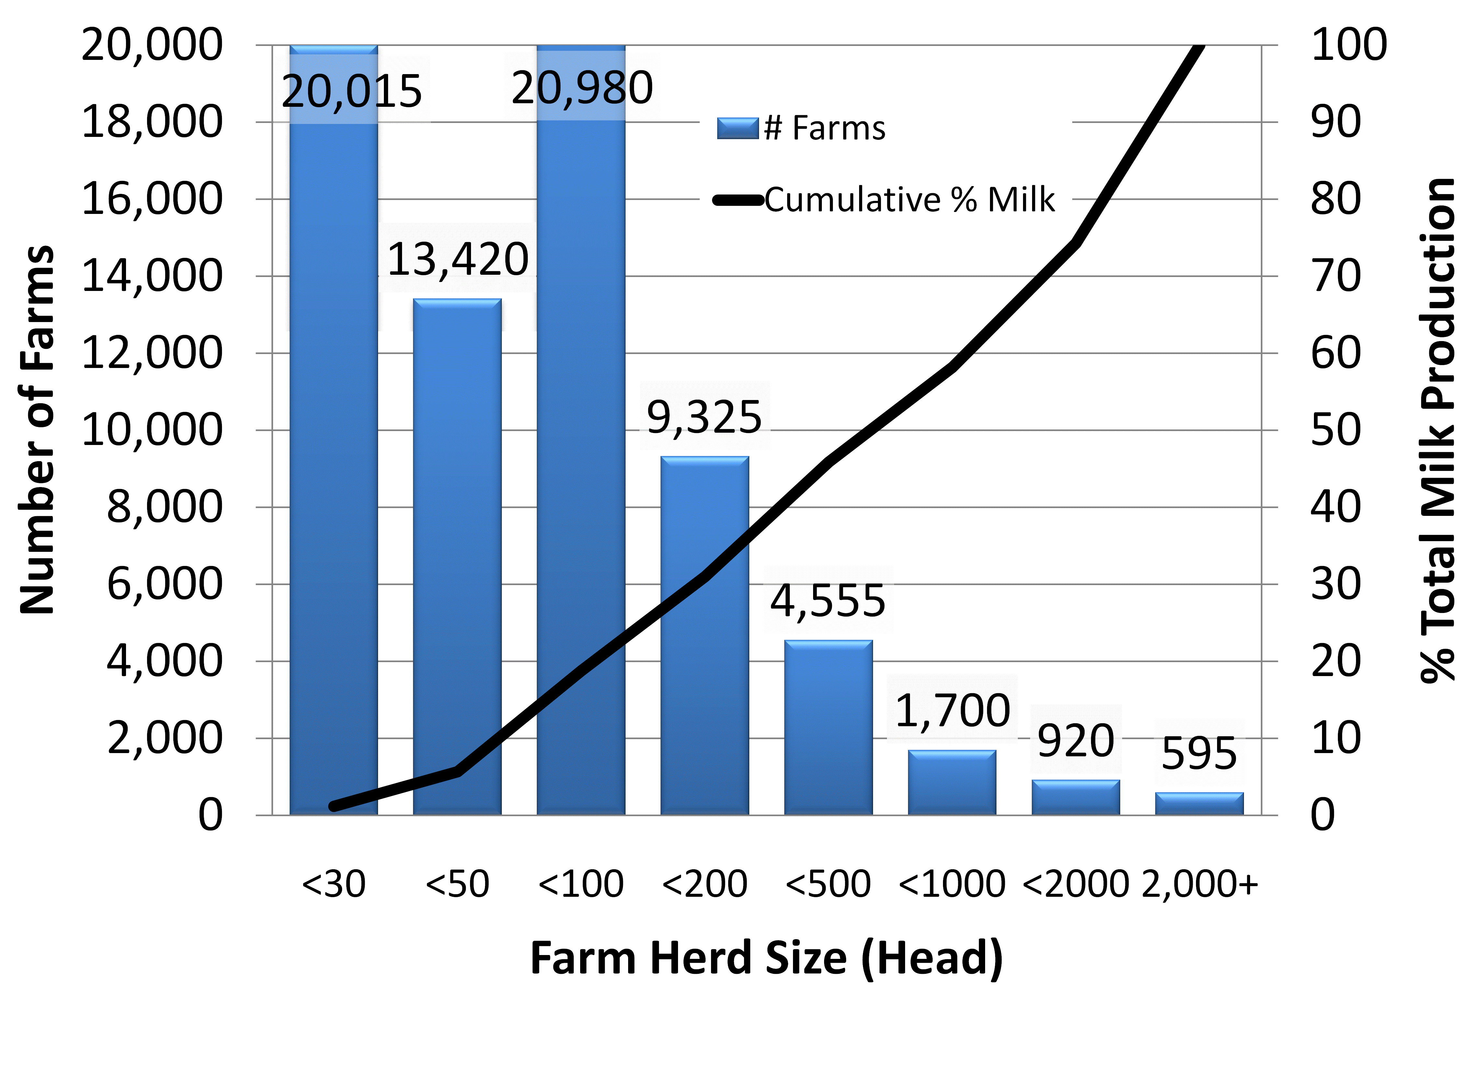
Producer Survey
43 questions in 9 areas
  About Your Facility
  On-Facility Crop Production
  Manure Management
  Energy Usage
  Housing & Milking Information
  Animal Feedstuffs & Grazing Practices
500+ usable surveys returned
Notes:
13
USDA Briefing Section 10b

Slide 14
Producer Survey Data
Tremendous effort from farmers
Generally very conscientious in providing information
  Despite multiple revisions, still some confusion
  Missing information
    Herd demographics often incomplete
    Manure management quantities inconsistent
    On-farm crop production data
    Animal diets – information runs the gamut!
Lesson:
  Farm scale analysis will need knowledgeable data collectors and very patient farmers

Slide 15
Data Management & Reconciliation
Each survey entered twice; copies compared and corrected by reference to original
Outliers identified
  (eg 13 day calving interval → months)
  Milk production
Missing data interpolated by substitution
with weighted regional average
  Herd demographics
  Dry matter intake (regional average ration used when missing)
  MUN, fat and protein

Slide 16
On-Farm Emissions
Enteric, manure, energy
Data from producer survey & existing models

Slide 17
Diet and Enteric Methane
Diet from survey matched with NRC feed database to determine relevant parameters:
  Crude Protein, DE, NE_{g}, NE_{L}, …
  Milk to Beef allocation calculations
Model Comparisons:
  Ellis DMI model has lowest RMSE
Biogenic GHGs
  Methane explicitly accounted
  Other biogenic carbon cycling is not explicitly accounted
    In line with current IDF discussions

Slide 19
Milk / Beef Allocation Choices
System expansion
  Beef from dairy not quite equivalent to ‘Angus’
  Culled cows similar to breeder stock; bull calves have no real equivalent
  LCA on US beef has not been completed
Biological / Causal
  Each feed has different conversion efficiency
  Determine digestible energy consumed for:
    Growth
    Milk production
  Determine total feed energy for milk and beef, use this to define allocation fraction – Then all emissions allocated with this ratio
Economic Value
Notes:
19
USDA Briefing Section 10b

Slide 20
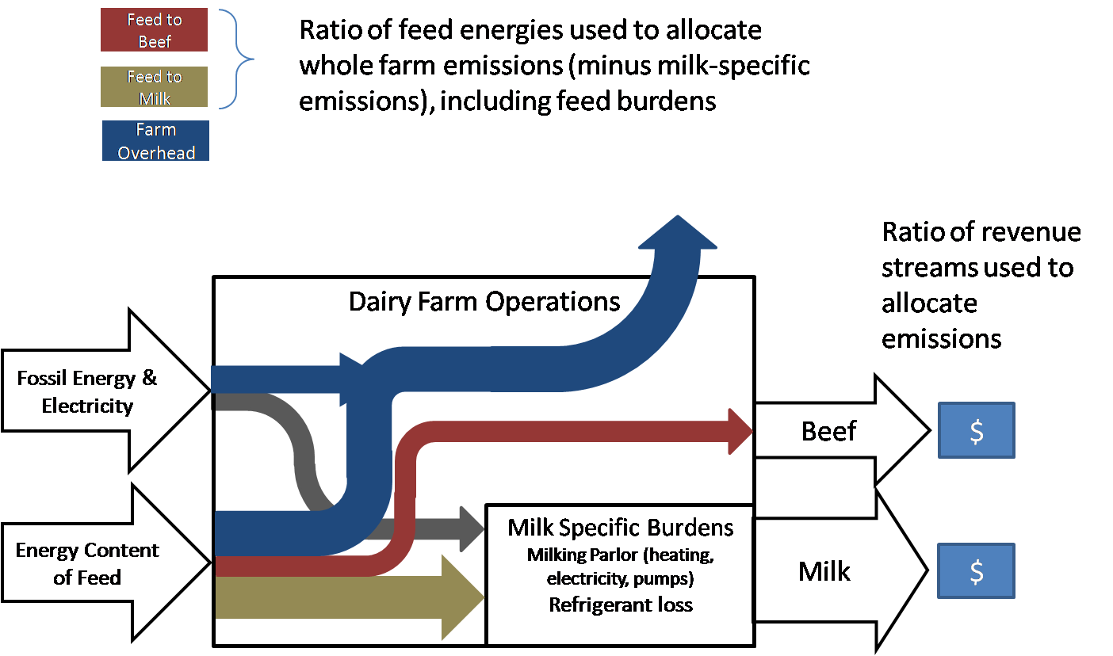
Schematic of energy flow accounting for allocation

Slide 21
Cradle to Farm Gate Results

Slide 22
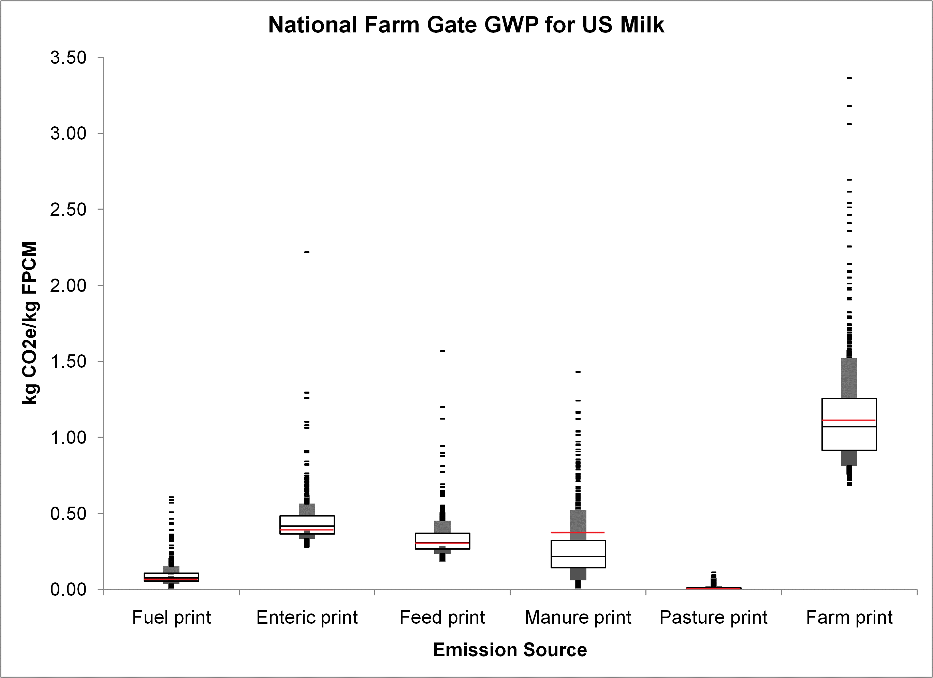

Slide 25
Farm Gate through Consumption
Highlights

Slide 26
Transportation of Raw Milk from
Farms to Processing Plants
~150,000 round trips (6000 gallon trucks) in 2007
Combined data from several dairy cooperatives.
– 11% of fluid milk delivered in 2007
Contained in this data for each trip:
Day of the year that the trip started, from 1 to 365, in 2007
Latitude and longitude of the plant
Latitude and longitude of each farm
Pounds of milk picked up at each farm

Slide 27
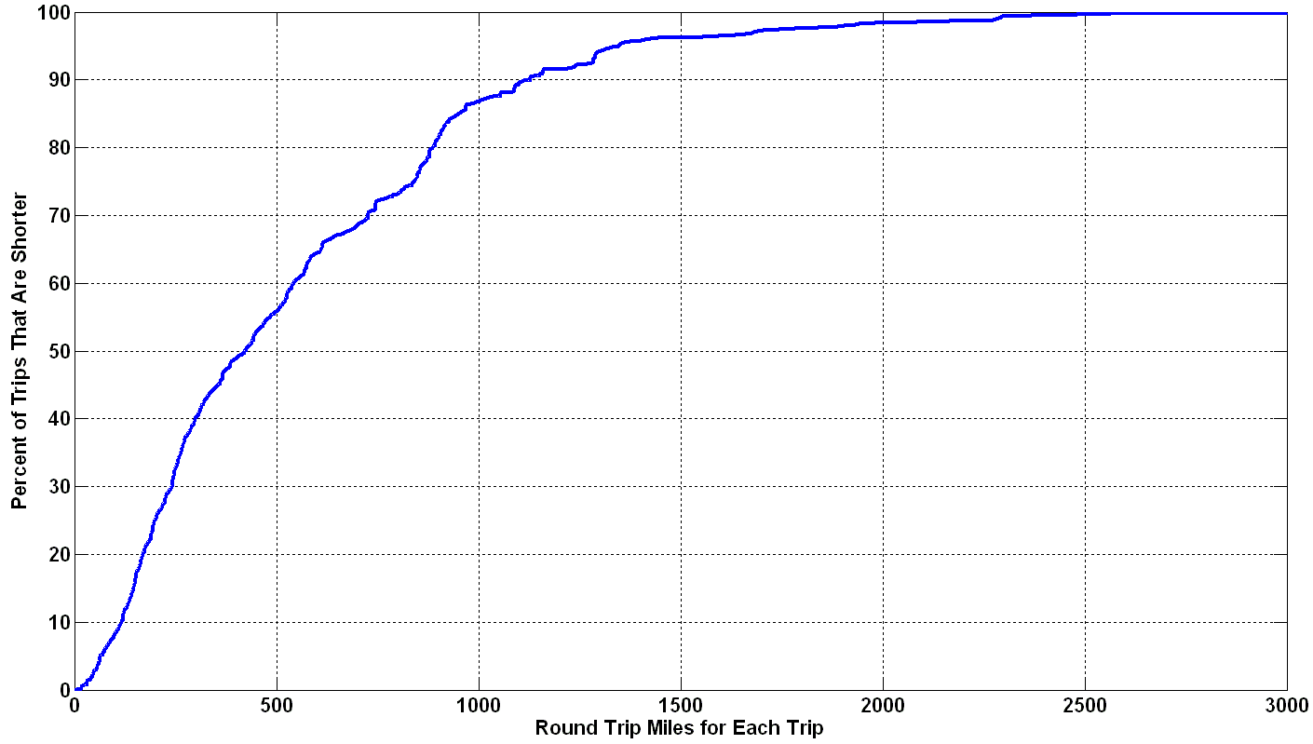
Cumulative Histogram of Trip Lengths
average =
490 miles
Raw milk is transported from farms to plants in unrefrigerated tank trucks.
Average round trip was 490 miles, delivering 5800 gallons of milk.
Heavy truck emissions were 2.13 kg CO_{2e}/mile.
Resulting emissions were 0.19 kg CO_{2e}/gallon milk delivered.

Slide 28
Milk Processing & Distribution
Processing (pasteurization), packaging, and distribution to retail

Slide 29
Processor Survey Details
Total of 50 processing plants provided data for 2007
  ~ 25% of all fluid milk processed in 2007
Data verification and analysis
  Two clarification rounds
  Detailed blow molding
  equipment specifications

Slide 30
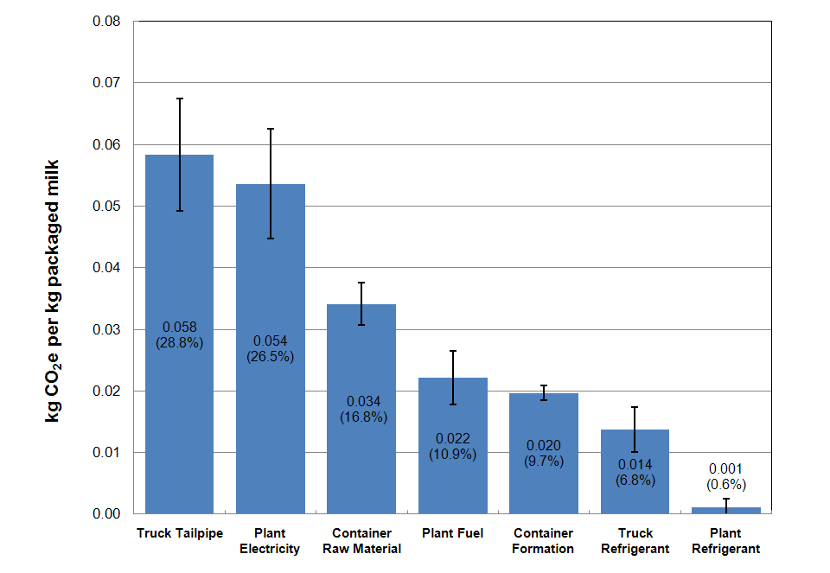
Processing Contribution to GWP
Gate-to-gate: 0.203 kg/kg

Slide 31
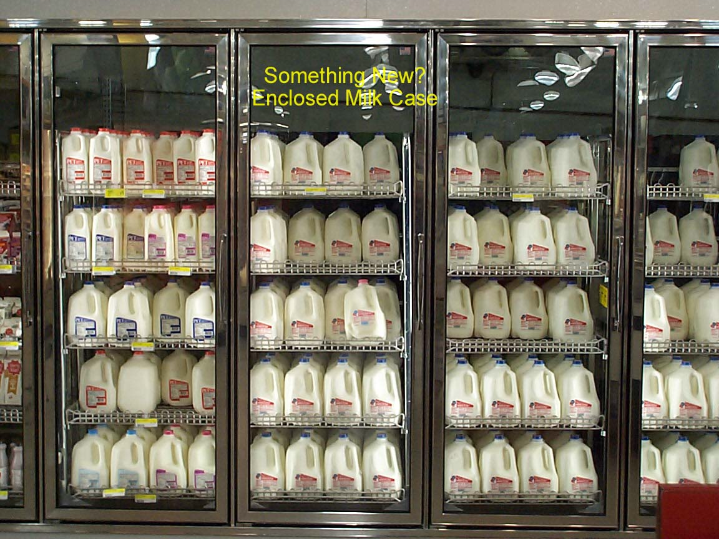
Retail allocation

Slide 32
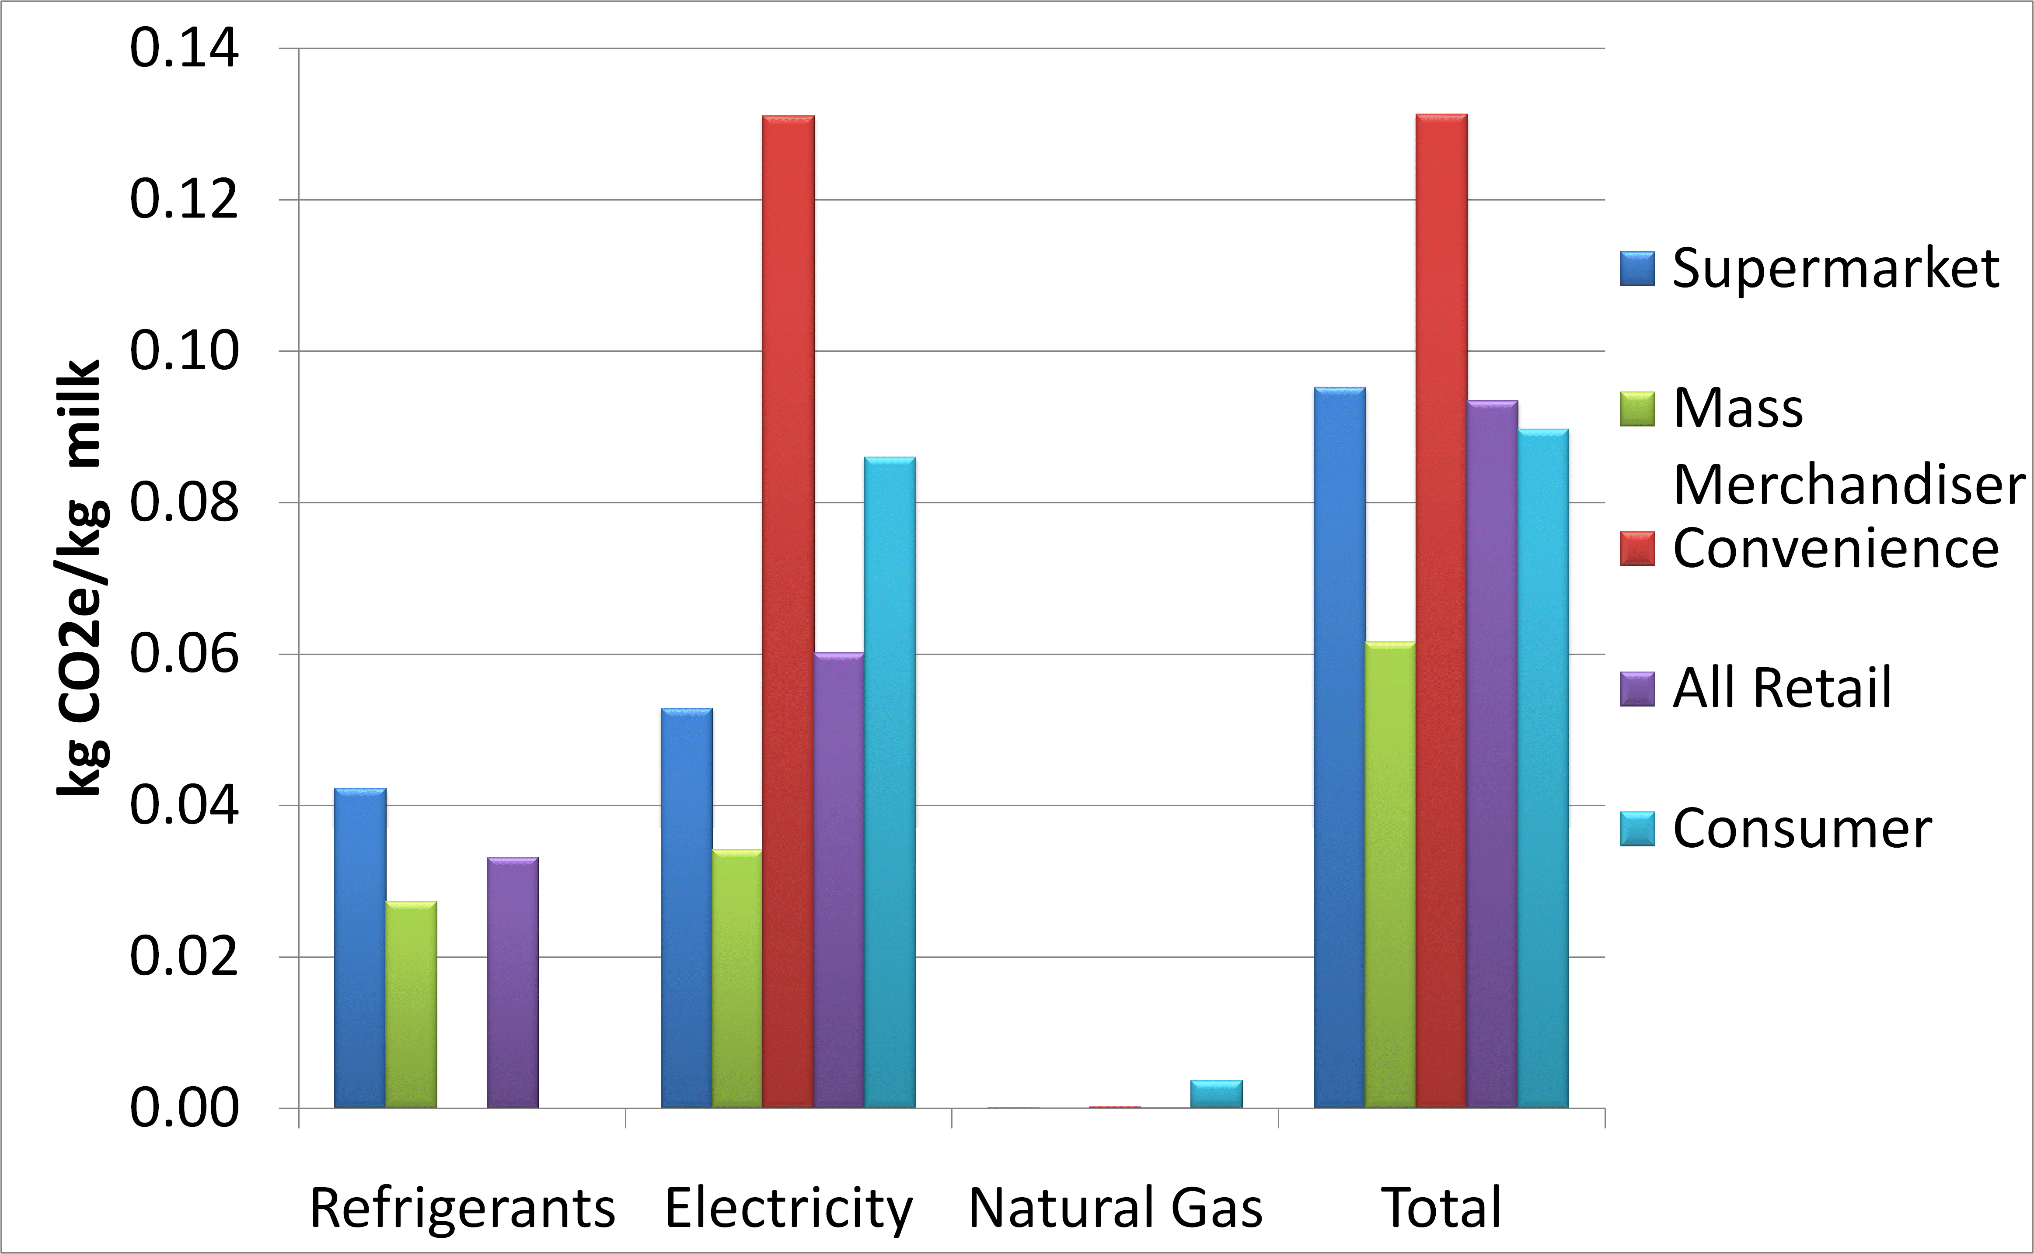
Retail/Consumer
Passenger Car

Slide 33
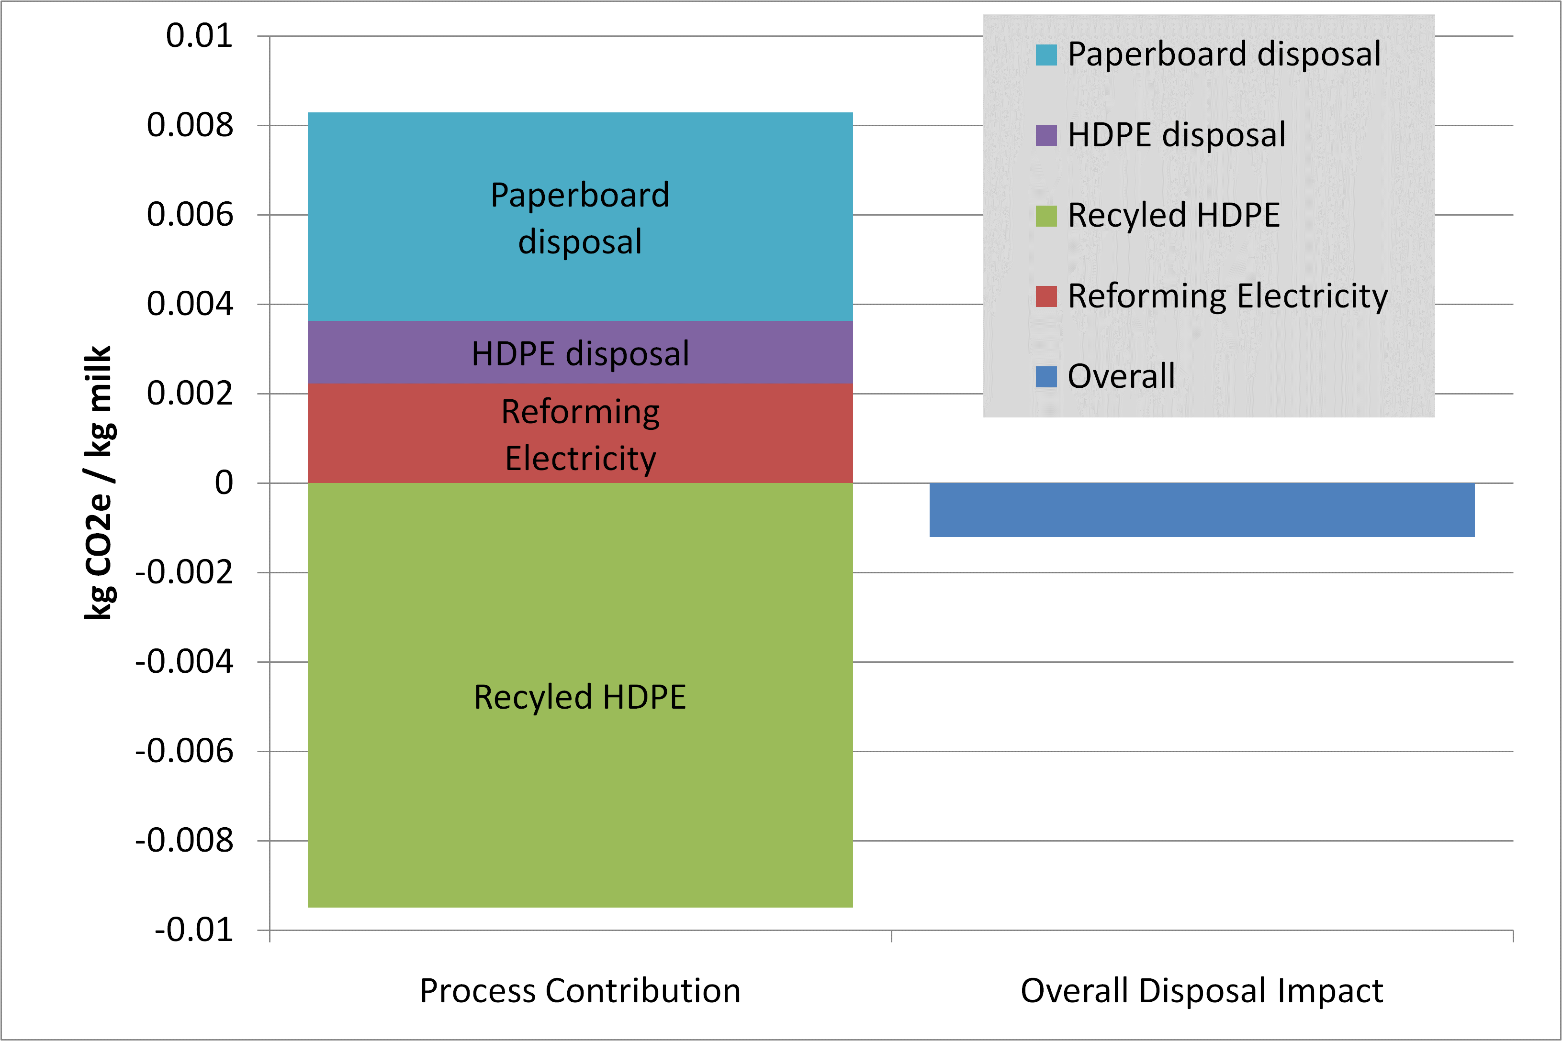
End-of-Life (Packaging disposal)
Notes:
33
USDA Briefing Section 10b

Slide 34
LCA Software Tools
Excel & VBA
MatLab
SimaPro 7.1 (Pre Consultants)
  Databases of LCI data
  Eco Invent
  US LCI
  Franklin Associates
EIOLCA http://www.eiolca.net
Open IO – Carbon http://www.open-io.org
Earthster http://www.earthster.org
  Open source data repository and computational engine

Slide 35
Supply Network
~100 of 2000+ linked unit processes that software and databases allow to be modeled, so your effort is focused on the closest processes of interest

Slide 36
Why an LCA of Milk Production?
Consumers are interested in product sustainability.
  Increasing willingness to make purchase decisions based on (perceived) environmental impacts.
  Potential for reduction in consumption of dairy.
Science-based LCA can provide:
  Data that will allow the industry to identify and engage more sustainable approaches
  Reduce environmental impacts that can be validated through LCA measurements.
Other benefits:
  Systems understanding allows positioning dairy products in the marketplace based on sustainable attributes respond proactively to consumer concerns.
  Supports industry’s ability to work with retailers to educate consumers about agricultural and food sustainability issues.
  Establish a baseline for GHG offset projects which may result from legislation in the future

Slide 37
Whose carbon is it?
ISO compliant LCA should be cradle to grave in scope
  Does the dairy farmer get credit for more efficient corn production?
  Yes: in the context of a full LCA accounting of the entire supply chain, they can legitimately claim milk has overall lower impact.
  AND
  No: in the context of carbon credits or carbon trading. Here the WRI concepts of Scope 1,2,3 are useful.
  Scope 1: on-site emissions (enteric methane, diesel combustion)
  Scope 2: indirect emissions (mostly electricity)
  Scope 3: indirect emissions further up the supply chain (N2O from fertilizer manufacture, or diesel combustion for commodity crop production)
LCA is a useful tool and framework for Scope 1 assessment, but for carbon trading full LCA is not really
appropriate

Slide 38
Summary
Bottom line: Milk LCA results
  Add up all the emissions → 1 gallon of milk consumed in the US is less than equivalent to burning 1 gallon of gasoline → driving 20 miles.
GHG Accounting in Agriculture
  Complex systems – crops, soil, climate interactions
  Data quality is likely to remain a concern – e.g., how much methane is really released at a particular farm?
  Allocation can significantly affect results
  Sensitivity analysis can highlight areas where good measurements are critical to proper assessment of the CF

Slide 39
Acknowledgements
Dairy Management, Incorporated
and
The Innovation Center for US Dairy

